Slide 1

Biometrics 101
Prepared by Christina Kinchen
February 2020 Training

Slide 2

How do I become a good Biometrics recruiter?
Understand the basics of what these candidates are doing. A general overview is enough to earn their trust.
Understand that Biometrics recruitment is a long term relationship that can take years to build.
Earn trust by sending appropriate positions, do not send a Biostatistician a SAS programing position.
Ask many questions! Ask about their work environment, why they want to move, and all the intro questions. The intro is very important! Learn what they are looking for and really understand what the ideal position looks like for them.
Always ask for referrals!

Slide 3

What is a CRF?
At the heart of every clinical trial is a hypothesis and to answer each hypothesis companies collect data for analysis.
A CRF or E-CRF is a Case Report Form. It is a paper or electronic questionnaire to collect data from each participating patient. The CRF will include information such as gender, DOB, blood pressure etc.
It is important to understand that Data Managers, SAS Programmers, and Biostatisticians are all working on the data generated by the CRF.
**Anything underlined are keywords for searches
This Photo by Unknown Author is licensed under CC BY

Slide 4


What does a Clinical Data Manager do?
A CDM (Clinical Data Manager) is making sure the data in a CRF makes sense and is accurate.
They do discrepancy management and query generation.
Their entire goal is to clean up the database to LOCK the database. Once the database is clean and locked others can now work with that data.
They use an EDC (Electronic Data Capture) database to organize and clean the CRF data. The most popular EDC database used is Medidata Rave, but InForm and Oracle Clinical are popular as well.
CRF Developers work with Data Mangers and Biostatisticians to develop the data collection tools. They create the electronic CRF forms so it captures all the necessary data.

Slide 5

What do SAS and Statistical Programmers do?
Now that all the data is clean and locked the SAS programmers can work with the data to create Tables, Listings, and Figures/Graphs (TLFs or TLGs) that Biostatisticians can work with.
SAS Programmers work side by side the Biostatisticians.
Many ask if there is a difference between SAS programmers and Statistical Programmers?
The short answer is No, they are the same.
Statistical Programmers and SAS programmers support the Biostatistics department.
Statistical programmers usually have more training in Statistics and understand what a Biostatistician is trying to do with the data.
Make sure to read the job description to know how much statistics is required.
This Photo by Unknown Author is licensed under CC BY-SA-NC

Slide 6
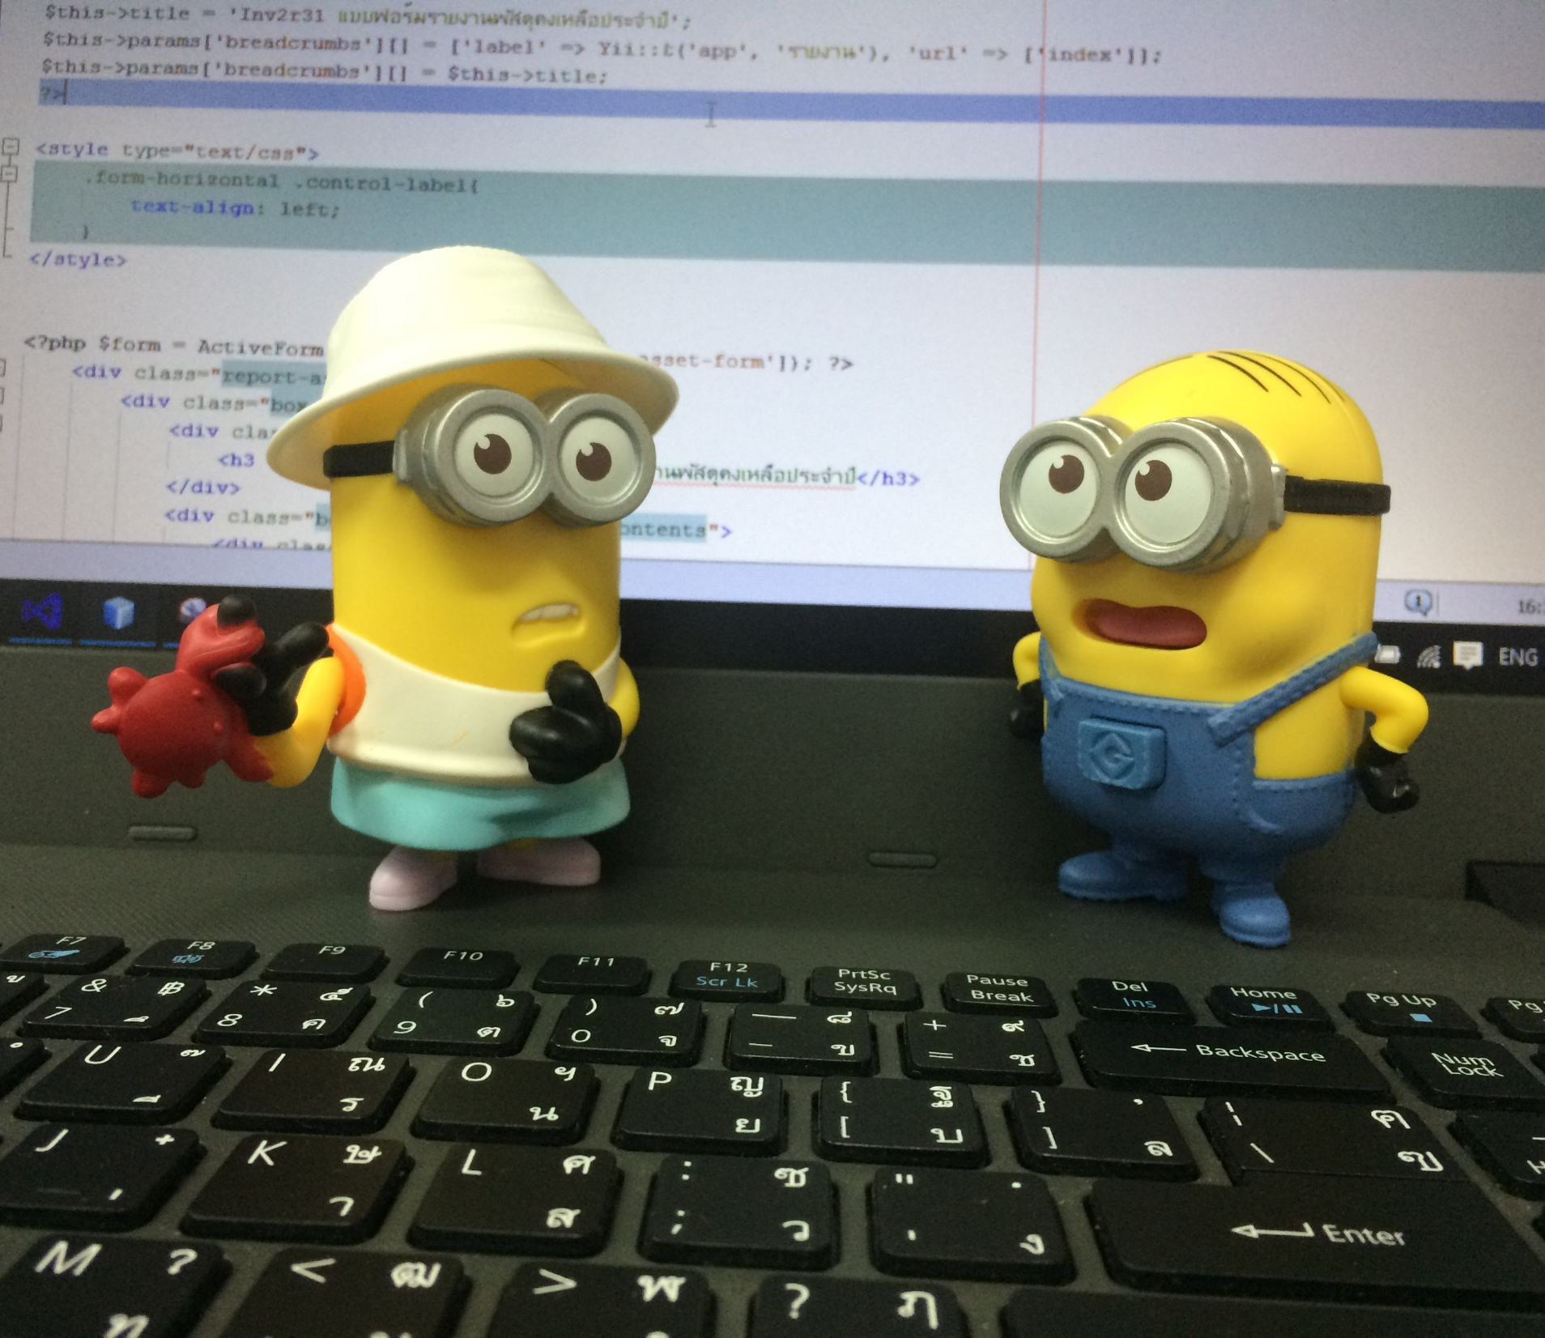
You will see SDTM, and ADAM on resumes. These are data standards the FDA now requires that fall under CDISC standards. Most companies will require SDTM or ADAM experience.
Most, if not all entry level SAS programmers on the market will have a Masters in Statistics or Epidemiology. Masters programs in statistics are having students become SAS certified as part of their program.
SAS Programmers can also support the Data Management department. They are usually referred to as Clinical Programmers if supporting CDM.
Things to look for is Rave , CRF, or EDC on their resume along with SAS.
A good question to ask is “Do you support Biostatistics or Data Management”?

Slide 7

Biostatisticians
The biostatistician contributes to the planning of a new study, they are involved in discussions on study objectives, and ultimately compiling and presenting the data in a way that gains approval from the FDA.
The protocol defines how a study will be conducted. The biostatistician is involved in defining appropriate study design, defining study objectives and providing statistical methods, all of which will be presented in the protocol.
They prepare the Statistical Analysis Plan (SAP), which describes the proposed analysis in detail. Biostatisticians are the only ones that work on the SAP
The biostatistician will work closely with SAS programmers who will write the SAS programs to perform the analysis; in practice the biostatistician may also write some SAS programs, and may perform validation and review the SAS programmer’s work.
Finally, the biostatistician will be involved in writing and reviewing the full Clinical Study Report (CSR), and any manuscript, poster or abstract submitted for publication of the study results.
Biostatisticians usually have a PhD in Statistics or Biostatistics
This Photo by Unknown Author is licensed under CC BY-NC

Slide 8

Questions to ask candidates
Clinical Data Managers:
What EDC system do you have experience with? If they do not mention Medidata Rave ask them if they have any Rave experience.
Do you have Oncology experience?
If they have a strong resume ask if they have lead experience.
SAS Programmers:
Do you have Oncology experience?
What clinical trial phases have you worked on?
Do you have SDTM or ADAM experience?
What degree do you have? (Look to see if they have a Statistics degree )
This Photo by Unknown Author is licensed under CC BY-SA

Slide 9

SAS Programmers continued:
Have you worked on any FDA submissions? If so how many?
Do you support Biostatistics or Data Management? 90% of the time they will answer Biostatistics, if they say Data Management find out if they have any experience working with the Biostatistics department.
Biostatisticians:
What clinical trial phases have you worked on?
Do you have Oncology experience?
Do you have experience write Protocols? SAPs?
Have you worked on any FDA submissions? How many?
Do you have any SAS programming experience? Depending on the answer you can ask what percentage of your time is working on programming and what percentage on statistics?
Do you have lead experience?
What degree do you have? (Or look on resume, want to see a PhD).

Slide 10

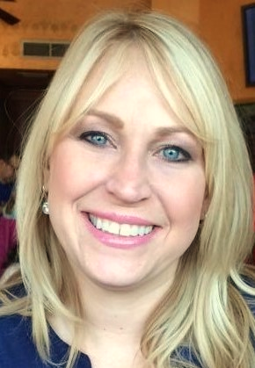
Questions?
This Photo by Unknown Author is licensed under CC BY-NC-ND

